Slide 1

Introduction to Big Data
Avadhoot Bhambare
bavadhoot@yahoo.com

Slide 2
Prologue
Sources of the content
Internet, Internet and Internet
hadoopilluminated.com
Some of the work by my colleagues, fellow data geeks at different meet up groups
Assumptions
Target audience is a novice in Big Data World
Not a hands on session
Suggestions are always welcome ☺

Slide 3
Who am I?
Data Geek
PMP certified IT PM with 11 years of exp
C++, Python, C#, Java technologies
Enthusiastic learner for Big Data
Completed Coursera course Introduction to Data Science
Completed the Hands on session by Paco Nathan - http://liber118.com/pxn/
Git hub repo

Slide 4
Table of Contents
What is Big Data?
Where does Big Data come from?
Examples of Big Data in the Real world
Sheer size of Big Data?
How Hadoop solves the Big Data problem?

Slide 5
What is Big Data?
Very large, loosely structured data set that defies traditional storage
Human Generated Data
Machine Generated Data

Slide 6
What is Big Data?
Human Generated Data
Data Size
Personal data – emails, documents, photos etc
Machine Generated Data
Logs, trackers, server data etc.

Slide 7

Where does Big Data come from?
The Cloud... Today
Over one billion web pages
350,000 iPhone apps
Over 100,000 Android apps
10,500 radio stations
5500 magazines
More than 300 TV networks

Slide 8
Where does Big Data come from?
Households generating 1TB
of data monthly
will grow by 20x
The Cloud... In coming years
Internet video petabytes per month will grow by 7x

Slide 9

Over 2 billion videos watched last year
600 videos equaling 25 hours uploaded in the last minute
9

Slide 10

Over 20 million subscribers
8 million with streaming-only
Streams on 250 consumer devices
10

Slide 11

Challenges of Big Data
Enormous Size
Unstructured/Semi structured
Can we store all this data?
Can we process this data?
Can we visualize this data?

Slide 12
Why Hadoop solves the Big Data problem?
Hadoop clusters scale horizontally
Hadoop can handle unstructured / semi-structured data
Hadoop clusters provides storage and computing

Slide 13












More Hardware Integration by very large end-users
They’re doing so with Open Source Components and Software
Increasing Direct Customer Purchases of storage by cloud providers, OEMs and resellers
13

Slide 14
How Hadoop solves the Big Data problem?
Hadoop Topology
Physical Topology
Software Stack
Hadoop Family

Slide 15
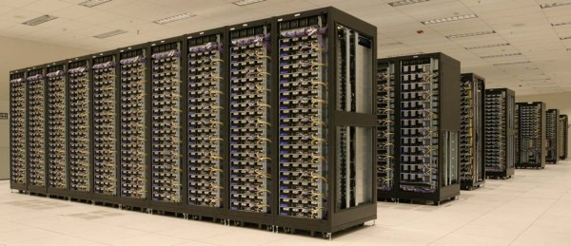
Large Datacenters, Data Warehouses
Cluster of machines running Hadoop at Yahoo!
(Image from quuxlabs.com, Source: Yahoo!)

Slide 16
Large Datacenters, Data Warehouses
Cluster
Rack
Server
Cluster of machines running Hadoop at Yahoo!
(Image from quuxlabs.com, Source: Yahoo!)
Over 170 PB (170,000 TB) of data

Slide 17
Physical Topology – Cluster
Cluster
Rack
Rack
Rack
Server
Server
Server
Server
Server
Server
Clients
Server
Server
Server
Server
Server
Server
Server
Server
Server
Server
Server
Server
Server
Server
Server
switch
switch
switch

Slide 18
Physical Topology – Hadoop Cluster
Cluster
Rack
Rack
Rack
Name Node
Data Node
Data Node
Data Node
Data Node
Data Node
Clients
Data Node
Data Node
Data Node
Data Node
Data Node
Data Node
Data Node
Data Node
Data Node
Data Node
Data Node
Data Node
Data Node
Data Node
Data Node
switch
switch
switch

Slide 19
Name and Data Node Software Ecosystem
Name Node
Responsibilities:
Data chunk map
Data chunk replication
Execute received jobs
Spawn tasks to data nodes
Data Node
Responsibilities:
Store data chunks (HDFS)
Execute received tasks
Store intermediate result files (non-HDFS)

Slide 20
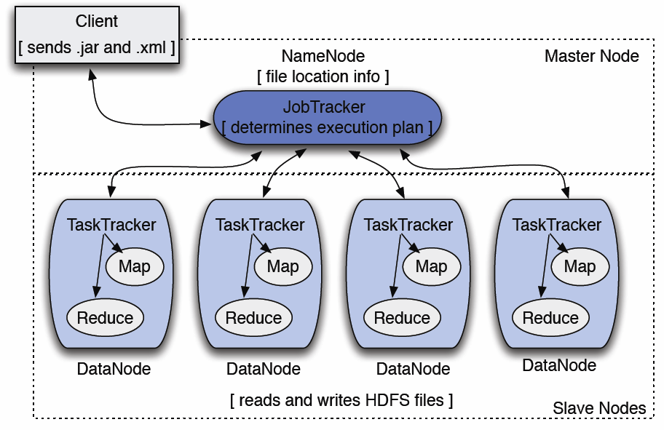
Name and Data Node Software Ecosystem

Slide 21



Hadoop Family
HDFS - Hadoop Distributed File System
Hadoop, the little elephant (Map Reduce)
HBase, the database for Big Data
ZooKeeper
Hive - data warehousing
Pig - Big Data manipulation

Slide 22
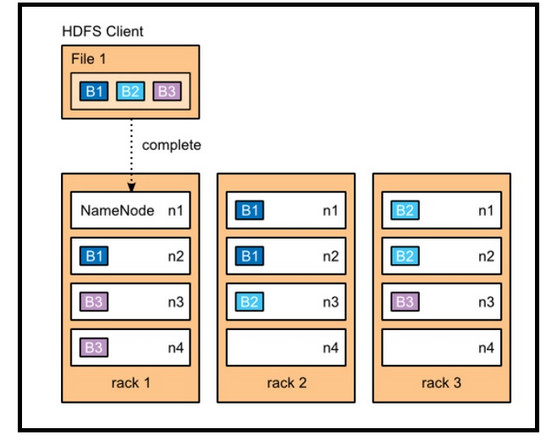
HDFS - Hadoop Distributed File System
Fault Tolerant
Commodity Hardware
Horizontal Scalability

Slide 23
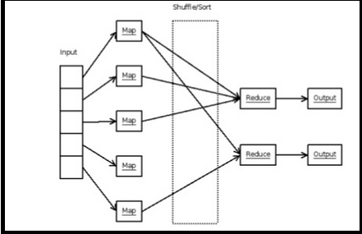
HDFS – Map Reduce
Distributed programming framework – Divide and Conquer!
Master divides work into digestible chunks and distributes to worker nodes
MAP
Work from nodes is then collected by the master and combined to form an answer
REDUCE

Slide 24
HBase, the database for Big Data
HBase is a database for Big Data, up to millions of columns and billions of rows
key-value database, not a relational database - they don't store nulls!

Slide 25

ZooKeeper
A service which helps to
coordinate distributed systems
Invented by Yahoo!
When all the Hadoop animals
(cluster members) want to do
something together, it is the ZooKeeper who helps them do it
They all know him and listen and obey his commands.

Slide 26

Hive - data warehousing
Hive: "I am Hive, I let you in
and out of the HDFS cages,
and you can talk SQL to me!“
Stared at Facebook –
Hive defines a simple SQL-like query language, called QL, that enables users familiar with SQL to query the data.
If your Hive program does not do almost what you need, you can call on your MapReduce skill. Hive allows you to write custom mappers and reducers to extend the QL capabilities.

Slide 27

Pig
MapReduce the easy way!!
High Level Data flow language used for Big Data manipulation
Alternative for Hive as its more easier to write and execute

Slide 28
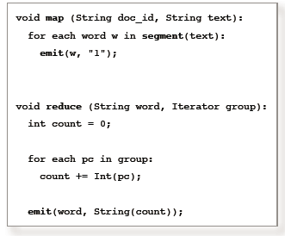
What do I do after knowing this?
If I am a Developer
Java Technologies
Scripting Languages
Unix/Linux preferred
Writing MapReduce Programs
Automation techniques
Need to be conversant with
maximum tools, DBs
Hadoop technologies
Software Engineering
Monitor and Govern the data flow in the cluster

Slide 29
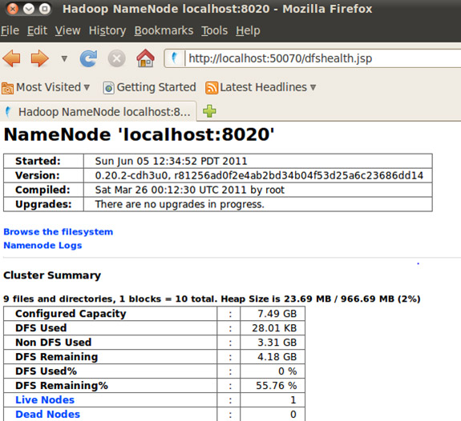
What do I do after knowing this?
If I am a Hadoop Admin
Network and Infrastructure set up
Network management
Cluster administration
Cluster monitor and expansion
Storage, Back up, DC set up
Configuration, Tuning,
DB and DC Job management
DBA background may help for this

Slide 30
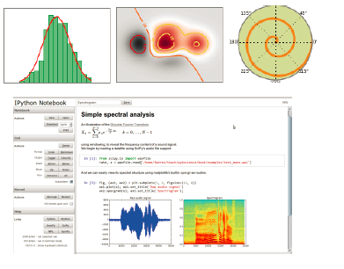
What do I do after knowing this?
If I am a Data Scientist
Mathematics and Statistics
Data Modeling
Machine Learning
Data mining algorithms
Figuring out hidden knowledge
from the data
Identify Patterns of the data for
business needs

Slide 31

What do I do after knowing this?
If I am a Data Analyst
Hive, Pig, BI tools
Data analysis
Data visualization
Business supporting roles
Domain Expert
Alliance between technical
and business teams

Slide 32
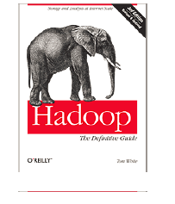
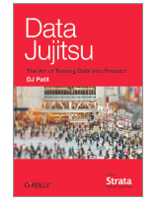
Further readings
Hadoop: The Definitive Guide
Tom White
Data Jujitsu
DJ Patil

Slide 33
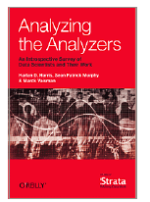
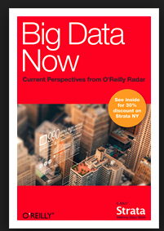
Further readings
Analyzing the Analyzers
Harlan Harris, Sean Murph,
Marck Vaisman
Big Data Now
OReilly

Slide 34

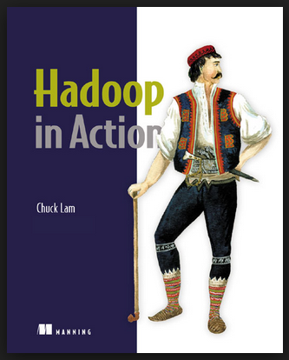
Further readings
Hadoop Illuminated
Mark Kerzner
Sujee Maniyam
Hadoop In Action
Chuck Lam

Slide 35
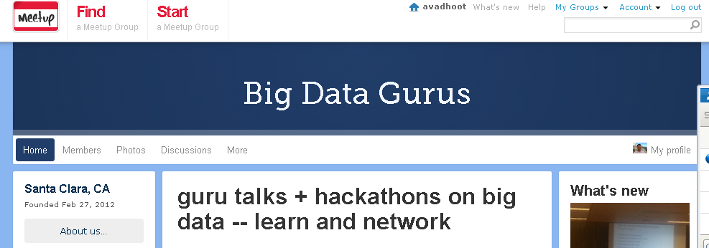
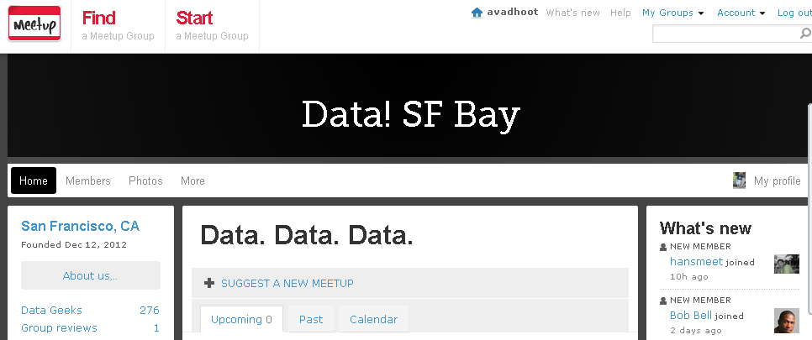
Meet up groups
Big Data Gurus
Data! SF Bay

Slide 36
Thank You !!!
Avadhoot Bhambare
bavadhoot@yahoo.com
http://www.linkedin.com/in/avadhootbhambare
Github

